Slide 1
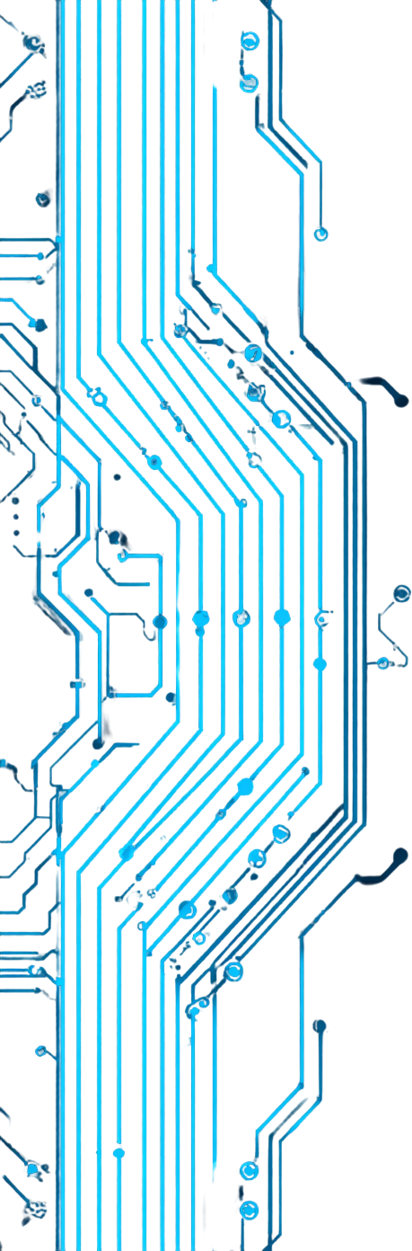

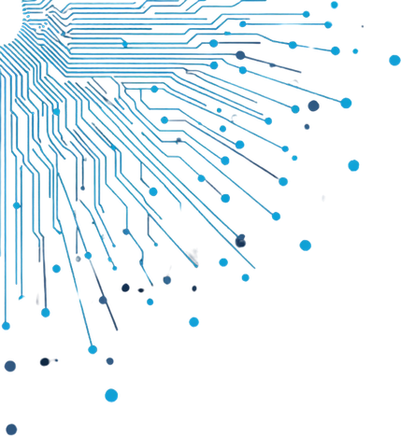



Progress Tracker
Web Application
A web-based system to track tasks and courses | Built using Flask (Python)

Slide 2



Problems
Users struggle to track learning progress across multiple courses and tasks with no centralized system in place.
Existing tools are overly complex and not personalized. A lightweight solution is needed to combine task and course management efficiently.
02
Presentation

Slide 3
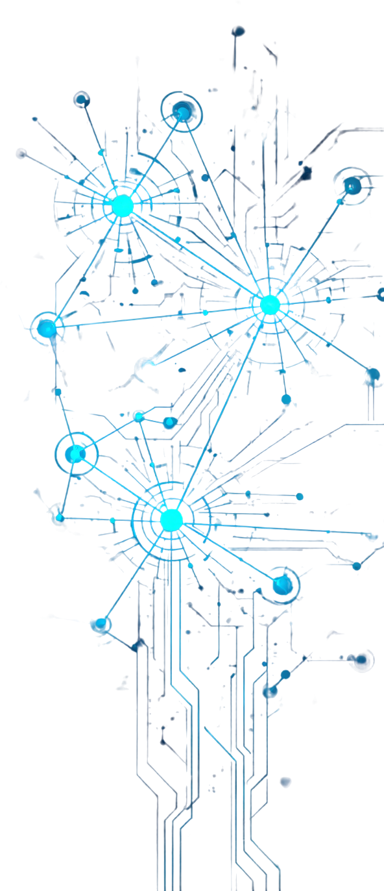


Methodology / Approach
Backend using Flask (Python)
Authentication with Flask-Login for secure user sessions
Database using SQLite and SQLAlchemy ORM
Frontend with HTML, CSS, and Jinja2 templating
Modular architecture with organized routes, templates, and static files
RESTful routing structure for clean URL management
Password hashing for enhanced security
Responsive UI design for cross-device compatibility
03
Methodology

Slide 4


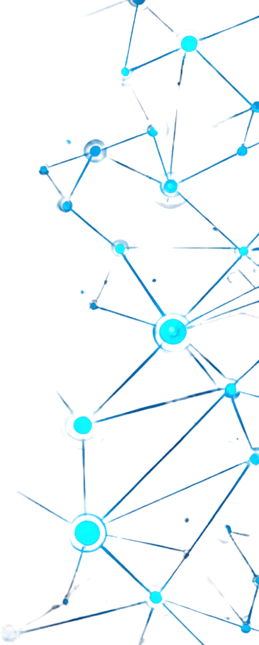
Results / Outcome
1.
Secure user registration and login system implemented with Flask-Login. Users can add, update, and track courses and tasks seamlessly. Responsive UI ensures accessibility across devices and screen sizes.
2.
Efficient SQLite data handling via SQLAlchemy enables fast and reliable data operations. A fully functional prototype demonstrates end-to-end progress tracking capabilities for students and self-learners.
04
Presentation

Slide 5
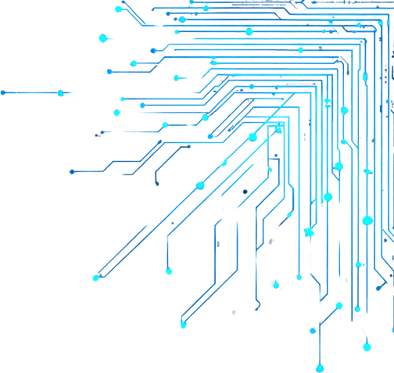


Conclusion
Successfully developed a full-stack Progress Tracker web application using Flask. Demonstrates practical implementation of Flask, SQLAlchemy, and Flask-Login in a real-world project. Future enhancements include interactive dashboards, REST APIs, and mobile integration. This application serves as a valuable tool for students and self-learners to monitor their progress effectively.
05
Presentation

